Slide 1

Ice Detection on
Fan Blade

Slide 2
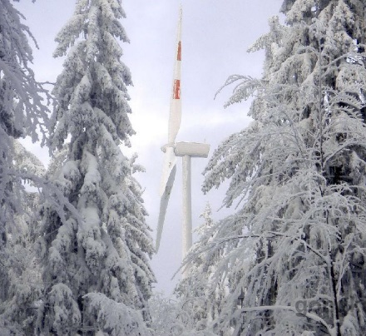
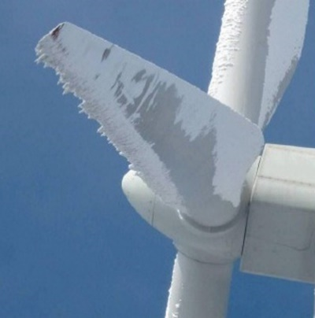
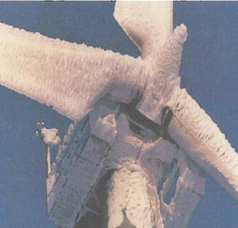
Background
Problems
Safety

Slide 3
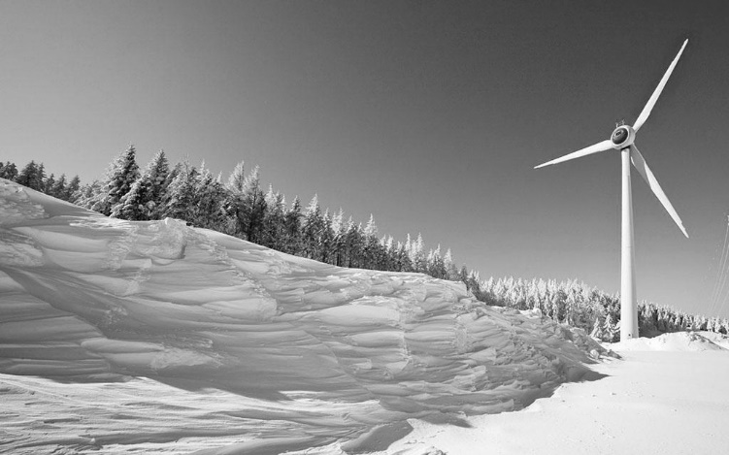
SCADA DATA
Ice Test
Exploring important monitoring parameters that can characterize fan blade icing
Identify external factors associated with blade icing (meteorological conditions)
Establishing high reliability blade icing warning method
Develop blade icing warning system and practical application

Slide 4
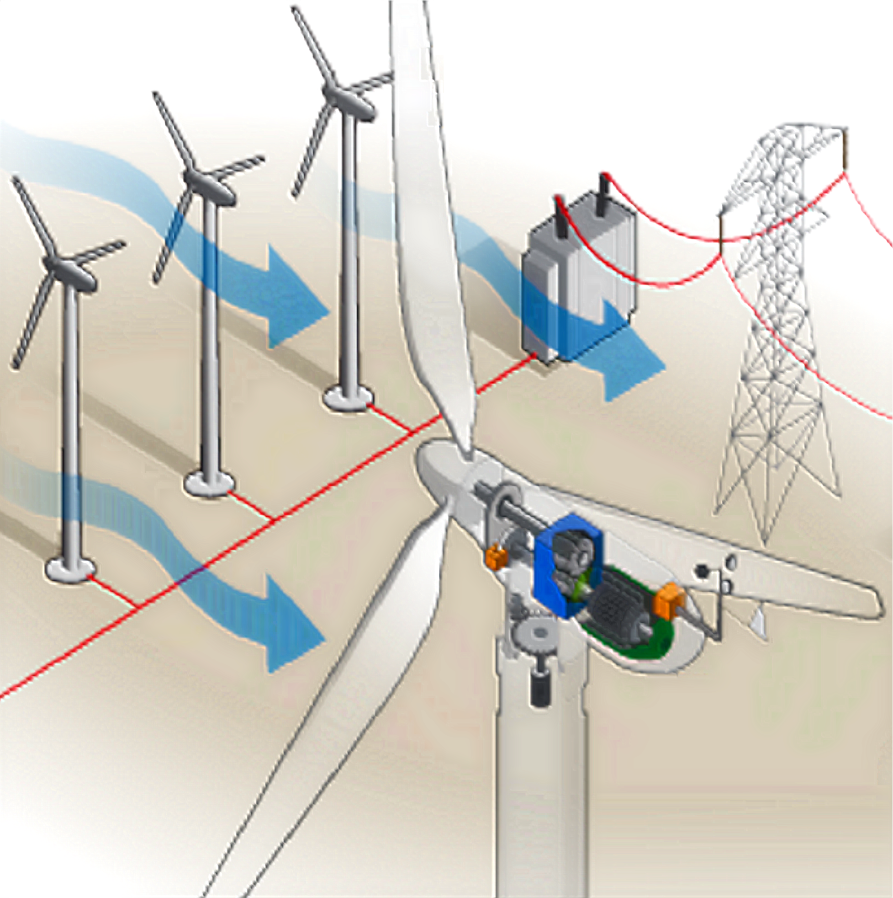
DATA OVERVIEW
TimeStamp
Blade ID
Temperature
Power
Fan direction
Rotation rate
Pitch angle
Pitch speed
Pitch motor temperature
Current motor battery, temperature
Wind speed
wind direction
Wind angle
Notes:
。

Slide 5
Data
Pre-Proceessing
Fan Blade data
Weather data
Fault number first-order differential processing
Divided by dimension
Fault occurrence interval marker
Separate effective data by label
Data Normalization, discard some samples, make the normal sample about twice the icing sample
Hourly data Matching SCADA Data

Slide 6
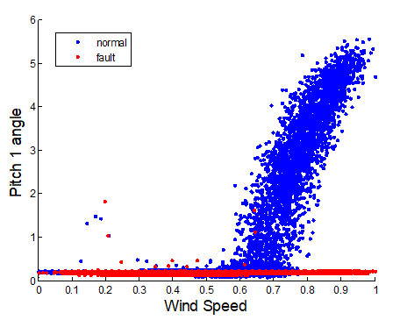
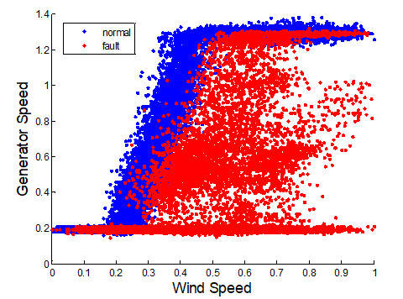
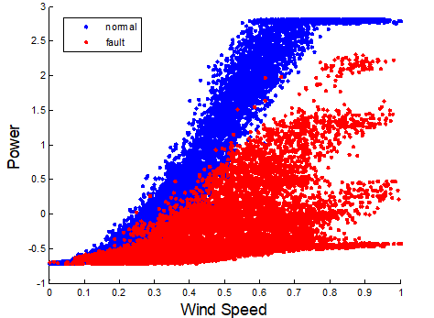
Feature
Analysis
Reasons of Blade Icing
Temperature, humidity, and temperature difference over time
Blade Icing External representation. Power difference = theoretical power - actual power
theoretical power
Actual power influenced by
Wind Speed、Wind Direction、Pitch Angle、 yaw angle、Generator Speed、 Yaw Position

Slide 7
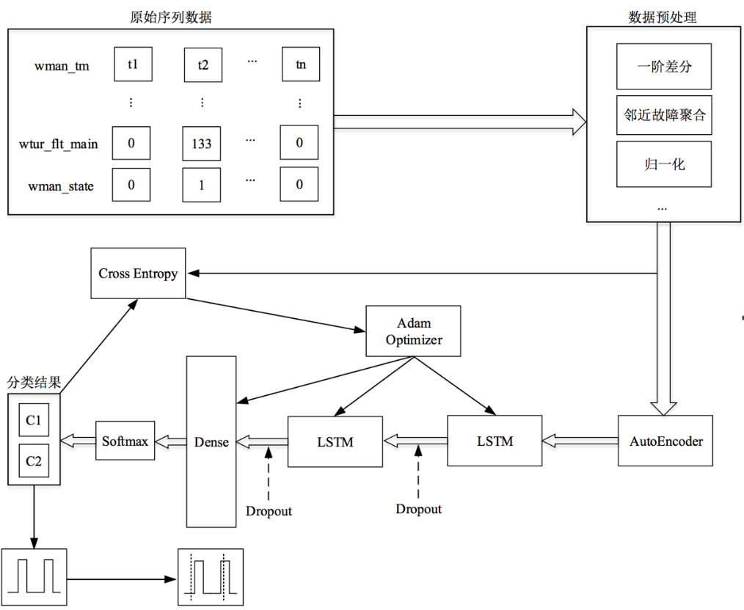
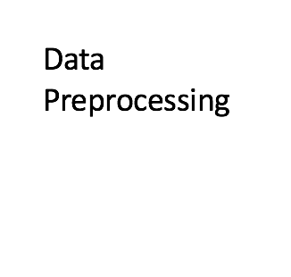
Model Building
Data Preprocessing

Slide 8
Model Optimization
Current moment data
Feature Selection
Additional data

Slide 9
Model Optimization
 | accuracy | recall | F1
Original features（27） | 0.8939 | 0.9540 | 0.9135
Selected features（20） | 0.8857 | 0.8591 | 0.8982

Slide 10
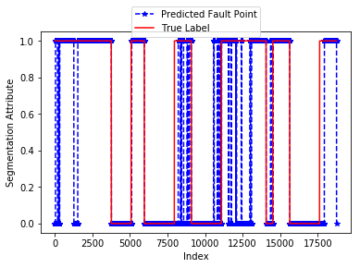
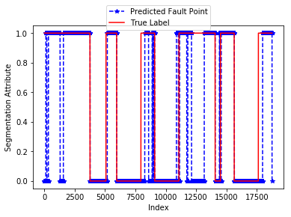
Early-Warning
Threshold | Accuracy | Recall | F1
0.5 | 0.8939 | 0.9540 | 0.9135
0.55 | 0.8933 | 0.9028 | 0.9085
0.6 | 0.8719 | 0.8311 | 0.8840

Slide 11
T H A N K Y O U !

